Slide 1
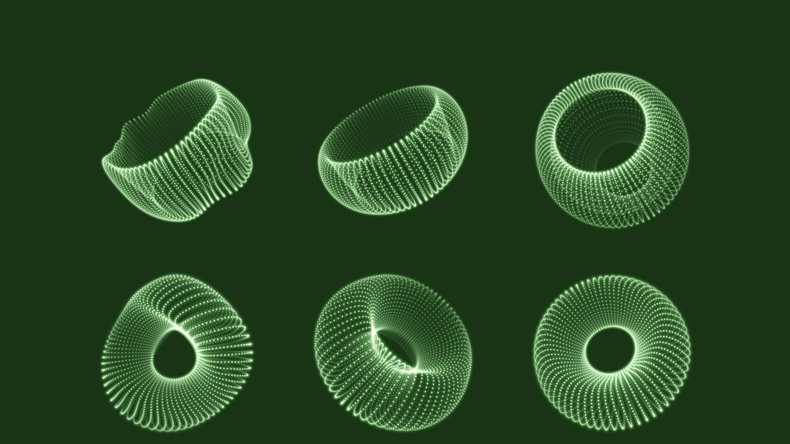
ProDiGi Project
By Team KOOverse

Slide 2
Index
Team Members
Problem Statement
Solution to Problem
Benefits of Cardano
Layout of Project

Slide 3
Team Members
Soubhik Pailan
Itasha Modi
Sagar Dutta
Parthiv Konwer
Jayshree Karmakar

Slide 4
Problem Statement
Online classes conducted by MS Teams are getting monotonous. Hence, the productivity is getting hampered, and the pace of learning is getting impeded.
Students are losing interest during classes due to the prolonged duration of idleness. Being constrained to sit for 3 - 5 hours with a mere 5 min break in between the classes is very tiring.
Students in online classes are not getting an opportunity to witness and utilize the assets of their university campus.
The absence of an application/platform to give a connected campus experience (MS Teams and Vtop are limited and only serve limited functionalities) makes students miss out on some marvelous opportunities.

Slide 5

Why these problems?
Inspired by the words of Peter Thiel " The most valuable businesses of the coming decades will be built by entrepreneurs who seek to empower people rather than make them obsolete" we set to build something to helps people.
In order to elevate the day-to-day productivity of college students and increase the efficacy of office employees for enhancing the overall output of the students.
Requirement of a one stop platform which could serve all the causes and simplifies the need for having multiple applications which aren't inter-compatible.
Providing students with an offline college experience with the additional comfort of them being in their homes.

Slide 6
Our Solution : KooVerse
A Cardano blockchain based Metaverse accessible through all platform whether Windows, Android, Web, AR or VR
Establishment of a gamified learning/working environment to build a platform that is more enjoyable and engaging. Fostering a healthy, friendly competition by adding leaderboards to public dashboards. The learner with the most badges, credits, points, stars, etc., sails to the top of the leaderboard which motivates others to work harder.
Offer virtual and augmented reality campus tours. Tools used are unity and other. Virtual reality is "the ideal fit" for astronomy instruction. When pupils encounter concepts visually, they suddenly make sense even when they are explained verbally.
Create a single, interconnected metaverse where everyone may interact, study, work, and play to foster a sense of community. The Cardano blockchain can be used to accomplish this.

Slide 7
Benefits of building on Cardano blockchain:
Cardano is a decentralized third-generation proof-of-stake blockchain platform and home to the ada cryptocurrency. It is the first blockchain platform to evolve out of a scientific philosophy and a research-first driven approach.
The Cardano platform has been designed from the ground up and verified by an industry-leading combination of top engineers and academic experts in the fields of blockchain and cryptography. It has a strong focus on sustainability, scalability, and transparency.
It is a fully open-source project that aims to deliver an inclusive, fair, and resilient infrastructure for financial and social applications on a global scale. One of its primary goals is to bring reliable, secure financial services to those people who do not currently have access.

Slide 8
Gamification
Similar to video games our metaverse comprises of some unique activities which would ensure a student remains hooked on their studies, along with spending quality time for recreational purposes :
Daily rewards – Attending all the classes regularly (+10 Exp for attending each class)
Main quest – Academics (CGPA * no. of credits*10, i.e., getting an 'A' grade in 3 credit course would get +270Exp )
Side quests – NASSCOM/COURSERA/other courses (Approximately +100 to 300 Exp each)
Limited time events – Hackathons/events/other competitions
Rewards – coins/points/ Discount-coupons which can be used in canteens

Slide 9
Revenue generation model:
Our Metaverse would generate revenue by issuing and storing its cryptocurrency.
From transaction fees when a user performs any transaction within our platform.
By selling our service to institutes , companies , communities etc.

Slide 10
Uniqueness
Most Metaverse projects till now were built on Ethereum blockchain. Very few Metaverses have been built on the more advanced Cardano Blockchain.
There are no Cardano Metaverses built to our knowledge that shares the same target audience as us (schools and colleges) and built with the same goal (increasing productivity in students) in mind.

Slide 11
Scalability
One of our primary motivators for using Cardano blockchain over other Blockchains is that other Blockchains are not designed to be scalable.
Cardano greatly aided by its consensus algorithm( Ouroboros) permits a decentralized way to elect a quorum of consensus nodes, which in turn can run more traditional protocols to accommodate the needs of large infrastructure providers.

Slide 12
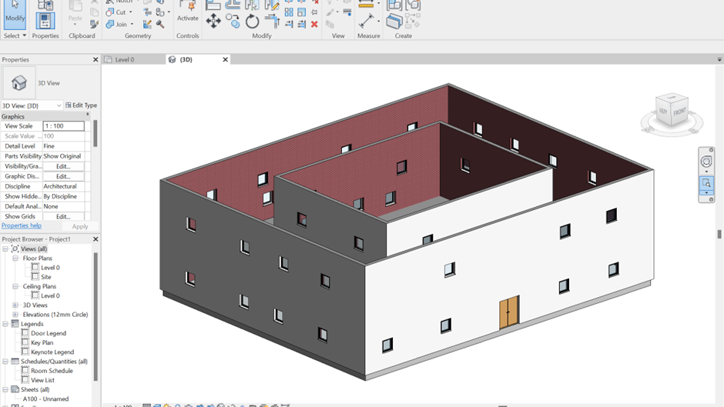
Building the Metaverse: Designing the Architectures in Autodesk Revit

Slide 13
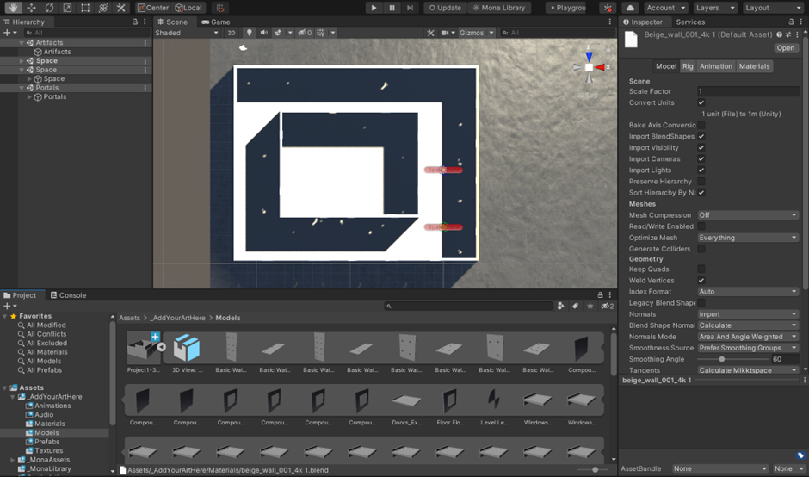
3D designing in Unity:

Slide 14
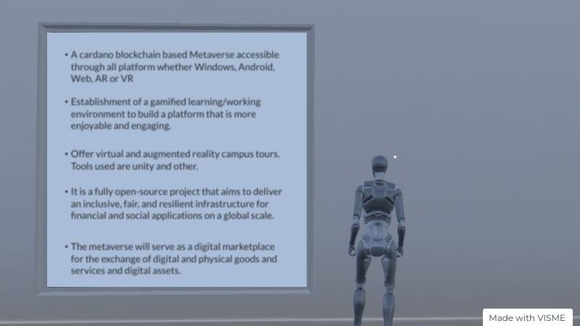
Metaverse Demo:

Slide 15
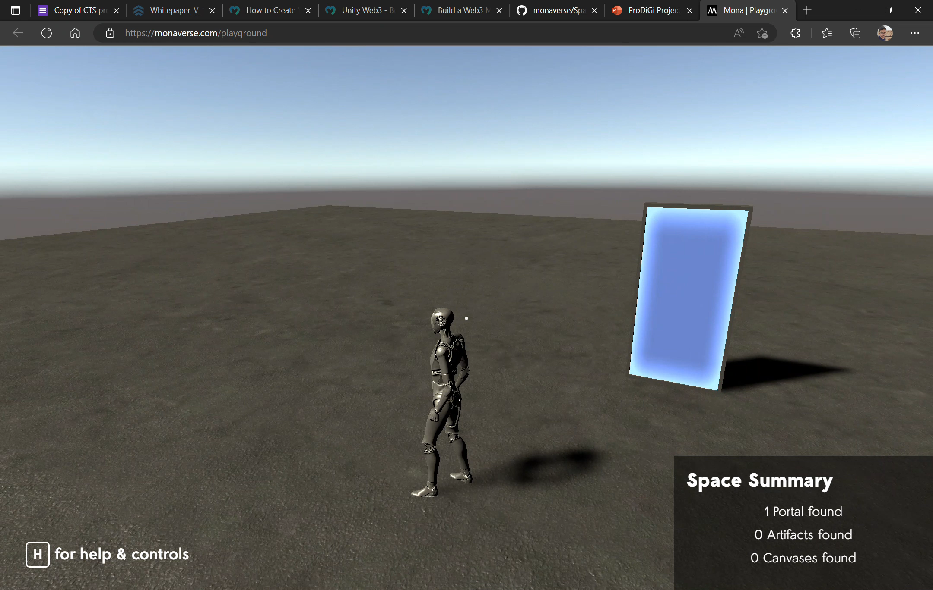
Character walking around in Metaverse

Slide 16
Thank You

